Slide 1
Implementation of Basic Logic Gates in real world application
Ashish Ranjan_21
Ameya Ganpatye_17
Shreerang Mhatre_29
Bind Gaurav_16
Sugandh Kedia_30

Slide 2
Logic Gates
A logic gate is a device that serves as a foundation for digital circuits. They carry out essential logical operations in digital circuitry.
Most electrical gadgets we use today have logic gates of some kind. Logic gates, for example, may be found in technology such as smartphones, tablets, and memory devices.
Logic gates in a circuit make judgments depending on a mix of digital signals from their inputs. The majority of logic gates have two inputs and one output.
Boolean algebra is the foundation of logic gates. Every terminal is in one of two binary states at any one time: false or true.
True represents 1 and falsely represents 0.

Slide 3
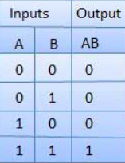

Burglar Alarm using AND Gate
The AND gate gets its name from the fact that if 0 is considered "false" and 1 is called "true," the gate behaves similarly to the logical "and" operators.
The circuit symbol and logic possibilities for an AND gate are shown in the figure and table below.
The input terminals are on the left in the symbol, while the output terminal is on the right. When both inputs are "true," the outcome is "true.“
Otherwise, "false" is returned. In other words, when both inputs one and two are 1, the

Slide 4
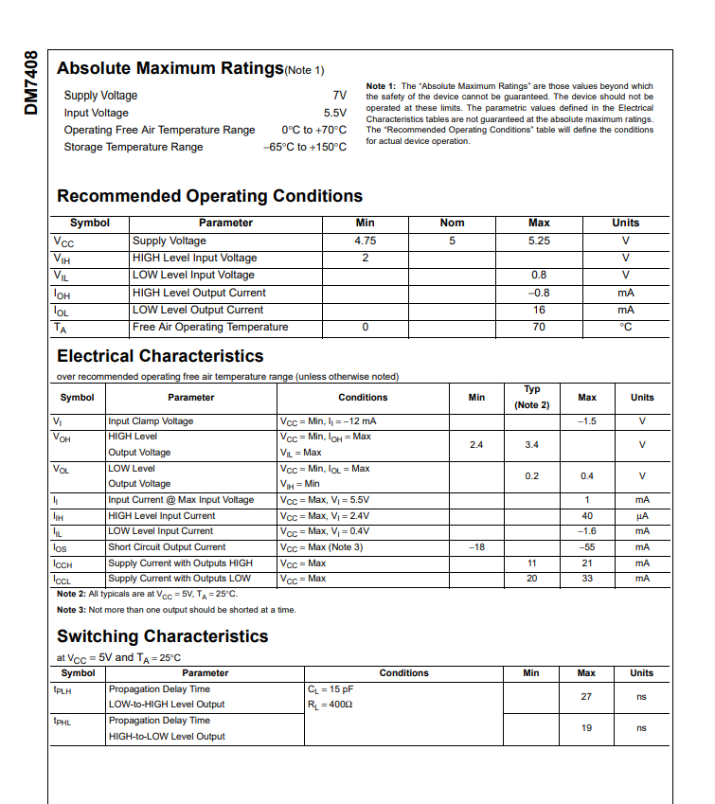
Datasheet of 7408 IC (AND GATE)

Slide 5
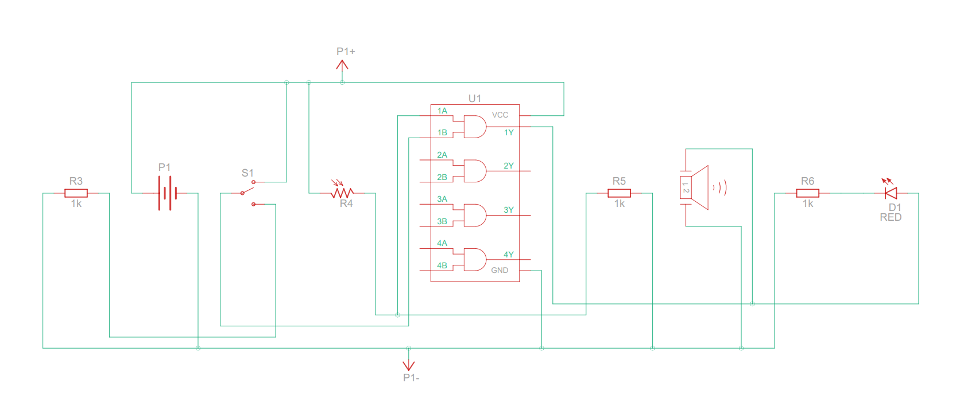
Circuit Diagram of Burglar Alarm

Slide 6
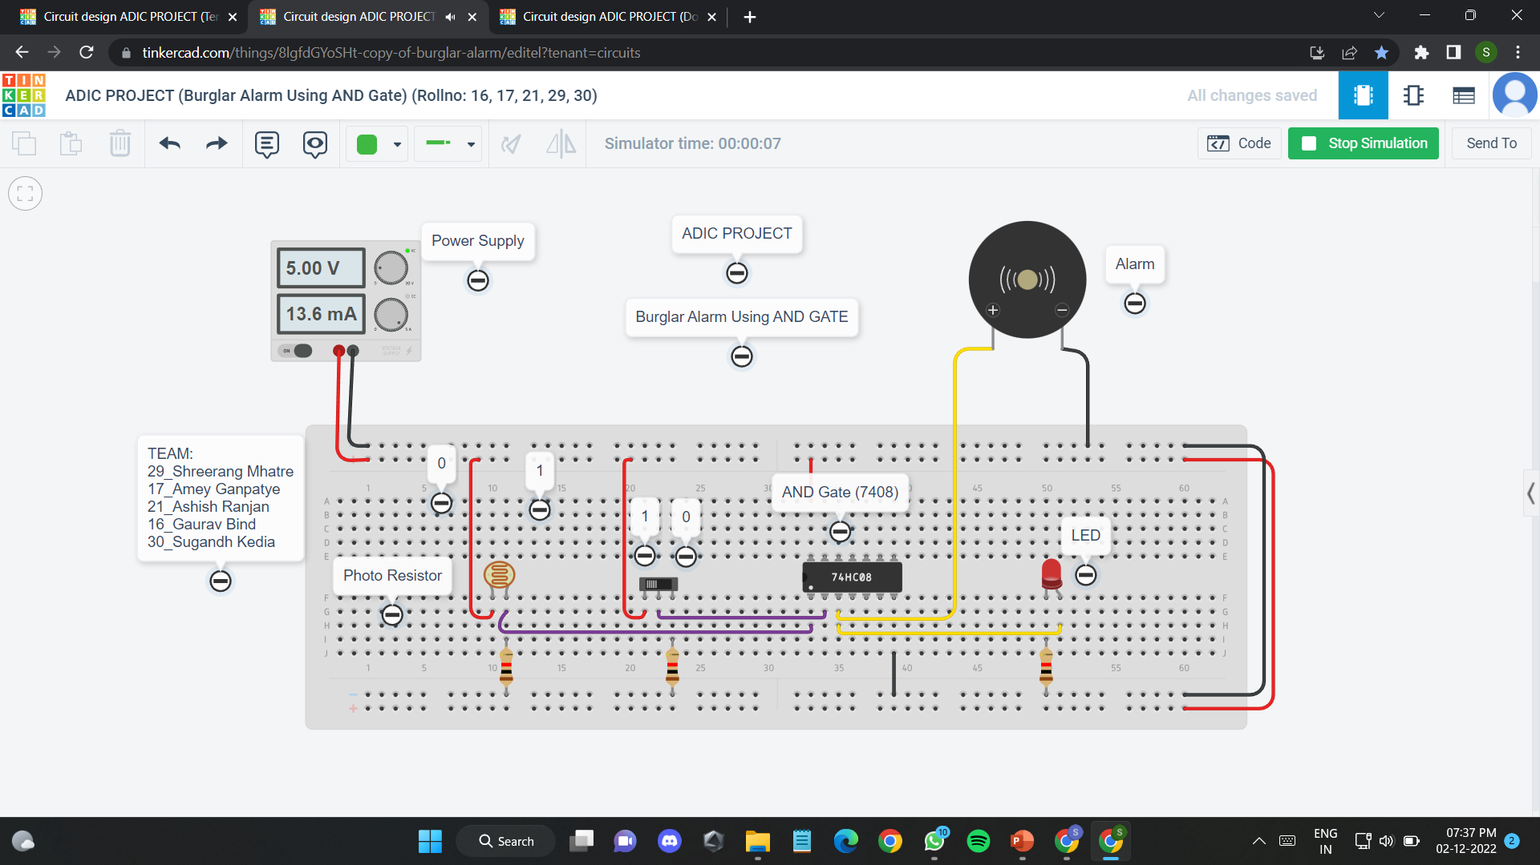
Simulation OF BURglar ALARM on TINKERCAD

Slide 7
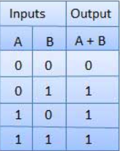

Door Bell using OR Gate
The Logic OR Gate is a sort of digital logic circuit that has an output that is HIGH to a logic level 1 only when one or more of its inputs are HIGH
When someone presses either the front door switch or the back door switch, the doorbell must ring.

Slide 8
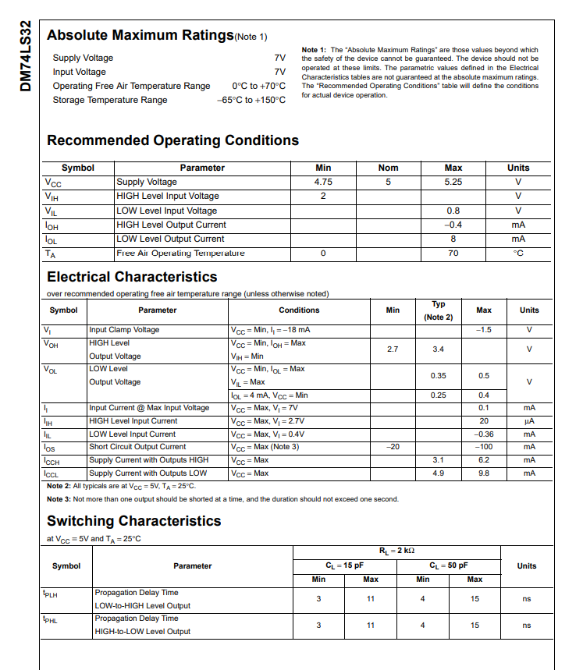
Datasheet of 7432 IC (OR GATE)

Slide 9
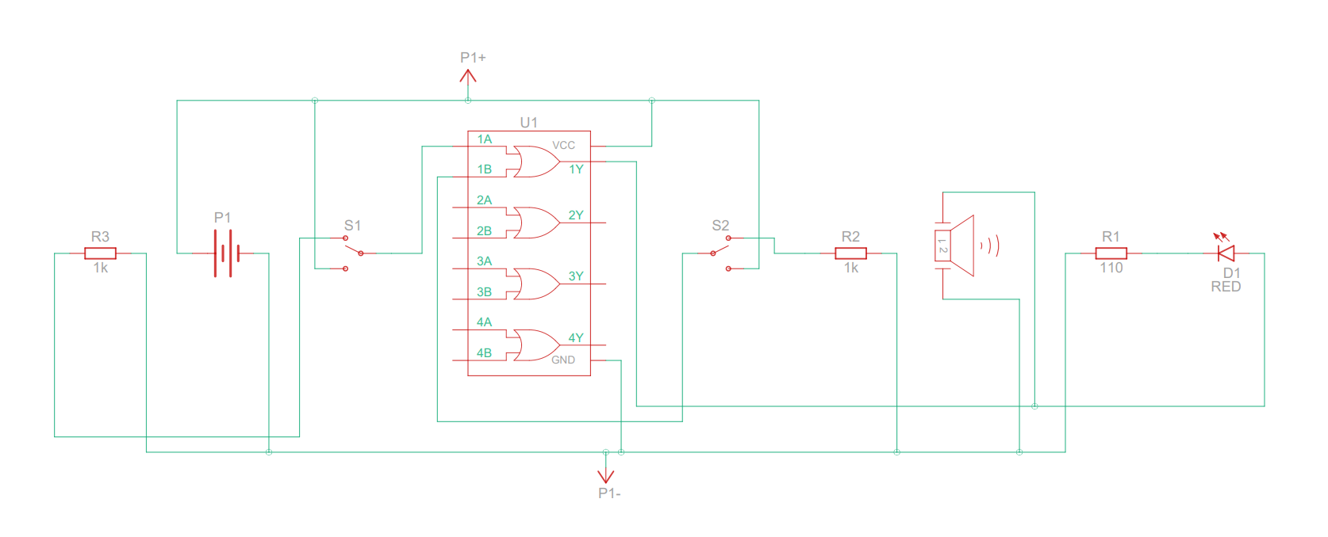
Circuit Diagram of DOORBELL

Slide 10
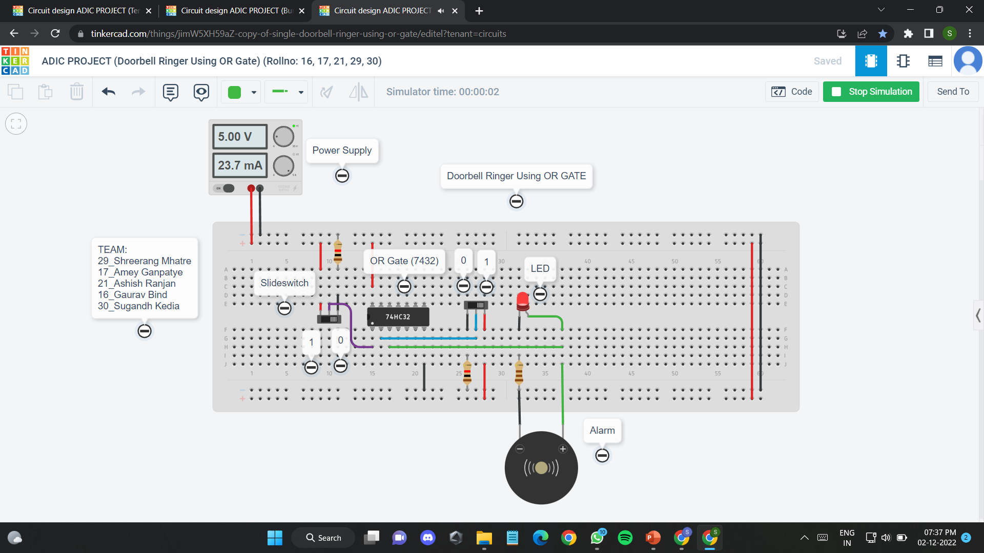
Simulation OF dOORBELL on TINKERCAD

Slide 11
Thankyou!!

